Slide 1




TACTICAL COMBAT CASUALTY CARE COURSE
Module 4: Principles and Application of TFC
#TCCC-CPP-PPT-04-01 08 AUG 23
COMBAT PARAMEDIC/ PROVIDER
MODULE 4:
PRINCIPLES AND APPLICATION OF TACTICAL FIELD CARE (TFC)
TCCC TIER 1
All Service Members
TCCC TIER 2
Combat Lifesaver
TCCC TIER 3
Combat Medic/Corpsman
TCCC TIER 4
Combat Paramedic/Provider

Slide 2




Module 4: Principles and Application of TFC
TACTICAL COMBAT CASUALTY CARE ROLE-BASED TRAINING SPECTRUM
ROLE 1 CARE
NONMEDICAL PERSONNEL
MEDICAL PERSONNEL
YOU ARE HERE
STANDARDIZED JOINT CURRICULUM
#TCCC-CPP-PPT-04-01 08 AUG 23
2
Notes:
Presenter
2023-11-22 10:34:21
--------------------------------------------
As a Combat Paramedic/Provider you are one of the first medical providers to care for the casualty and initiate more advanced treatments. As such, it is important that the you understand the roles and responsibilities of the nonmedical personnel (ASM and CLS) and other medical personnel (Combat Medic/Corpsman) that may be providing care/assisting in care in the prehospital environment.

Slide 3
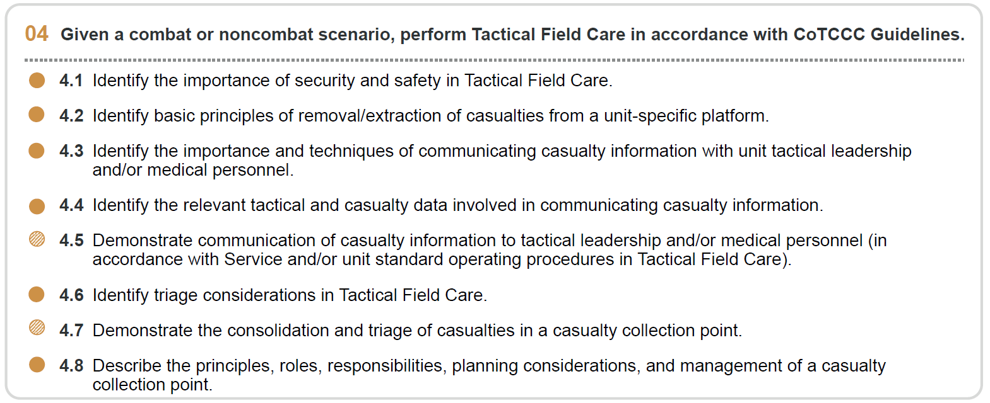










Module 4: Principles and Application of TFC
1 x TERMINAL LEARNING OBJECTIVES
04
Given a combat or noncombat scenario, perform Tactical Field Care in accordance with CoTCCC Guidelines.
  Identify the importance of security and safety in Tactical Field Care.
  Identify basic principles of removal/extraction of casualties from a unit-specific platform.
  Identify the importance and techniques of communicating casualty information with unit tactical leadership and/or medical personnel.
  Identify the relevant tactical and casualty data involved in communicating casualty information.
  Demonstrate communication of casualty information to tactical leadership and/or medical personnel (in accordance with Service and/or unit standard operating procedures in Tactical Field Care).
  Identify triage considerations in Tactical Field Care.
  Demonstrate the consolidation and triage of casualties in a casualty collection point.
  Describe the principles, roles, responsibilities, planning considerations, and management of a casualty collection point.
08 x ENABLING LEARNING OBJECTIVES
= Terminal Learning Objectives = Cognitive ELOs = Performance ELOs
#
#TCCC-CPP-PPT-04-01 08 AUG 23
3
Notes:
Presenter
2023-11-22 10:34:21
--------------------------------------------
There are six cognitive and two performance learning objectives for the Principles and Application of Tactical Field Care module. The cognitive learning objectives are to identify the importance of security and safety, identify the basic principles of removal/extraction of casualties from a unit-specific platform, identify the importance of and techniques for communicating casualty information with unit leadership and/or other medical personnel, identify the relevant tactical and casualty data for communicating casualty information, identify triage considerations in Tactical Field Care, and describe the principles, roles, responsibilities, planning considerations, and management of a casualty collection point. The performance learning objectives are to demonstrate communication of casualty information to tactical leadership and/or other medical personnel and demonstrate the consolidation and triage of casualties at a casualty collection point.

Slide 4
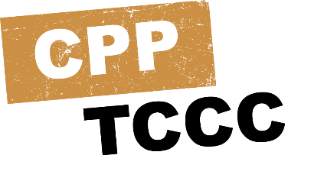

Three PHASES of TCCC
Module 4: Principles and Application of TFC
₁ CARE UNDER FIRE (CUF)
/ THREAT
RETURN FIRE AND TAKE COVER
2
TACTICAL FIELD CARE (TFC)
WORK UNDER COVER AND CONCEALMENT
₃ TACTICAL EVACUATION CARE (TACEVAC)
MORE DELIBERATE ASSESSMENT AND PRE- EVACUATION PROCEDURES
YOU ARE HERE
Notes:
Presenter
2023-11-22 10:34:21
--------------------------------------------
Tactical Field Care is the second of three phases of Tactical Combat Casualty Care. It is the care provided once the responder and casualty are no longer under direct threat from effective enemy fire. This allows for the time and the relative safety for a more deliberate approach to casualty assessment and treatment.
Keep in mind that the duration of the TFC phase of care could vary from minutes to hours depending on the tactical situation and the availability of evacuation assets.

Slide 5

PHASE 2: TACTICAL FIELD CARE
Module 4: Principles and Application of TFC
After CARE UNDER FIRE (CUF), conduct more deliberate assessments and care following the MARCH PAWS sequence
IMPORTANT CONSIDERATIONS:
Mission personnel should constantly maintain their situational awareness of the potential threat from hostile forces
REMEMBER: The Tactical Situation could REVERT back to CUF at any time
TFC IS RENDERED WHEN THERE IS NO LONGER A DIRECT THREAT OR EFFECTIVE ENEMY FIRE
Notes:
Presenter
2023-11-22 10:34:21
--------------------------------------------
Tactical Field Care, or TFC, is the care rendered by the first responder, Combat Lifesaver, Combat Medic/Corpsman (CMC), and/or Combat Paramedic/Provider and there is no longer a direct threat or under effective enemy fire. TFC also encompasses care in the combat/tactical environment not involving enemy fire, such as a parachute injury or vehicle crash. The TFC environment allows the time and relative safety for the medic to assess and treat casualties more deliberately following the MARCH PAWS algorithm. Keep in mind that the tactical situation could revert to care under fire at any time.

Slide 6
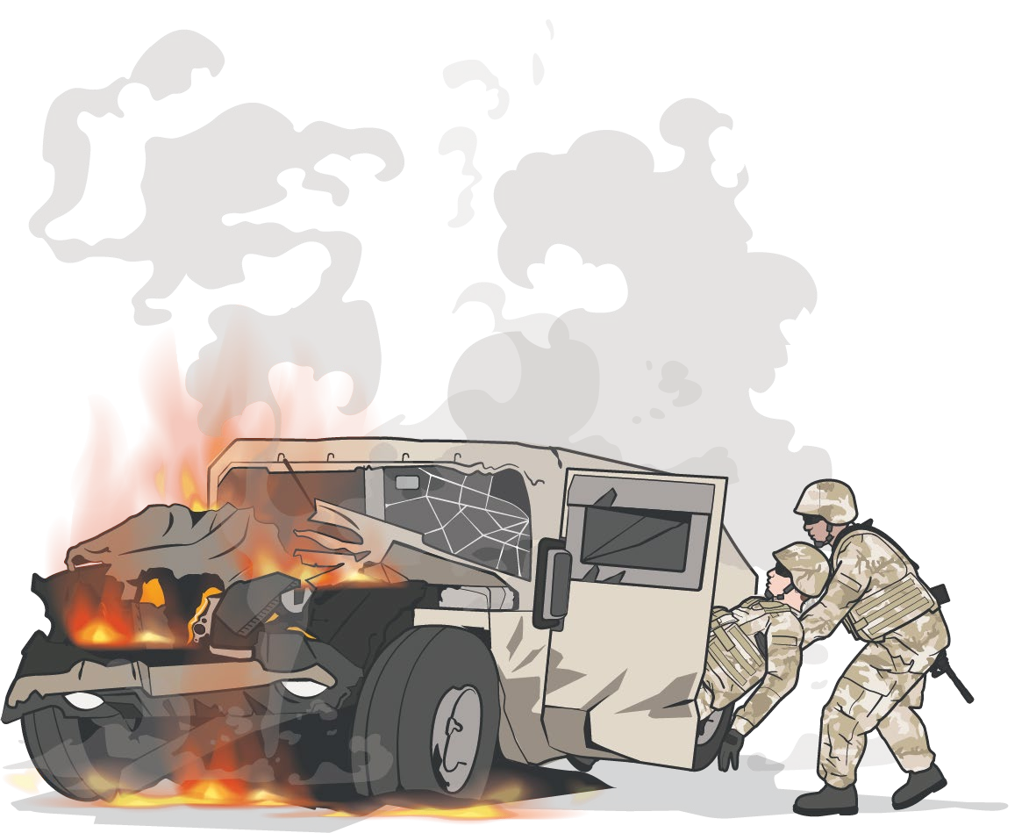
CASUALTY REMOVAL/EXTRACTION PRINCIPLES
Module 4: Principles and Application of TFC
PRINCIPLE 1:
SAFETY is critical
PRINCIPLE 2:
MARCH still applies. If possible, you may want to initiate lifesaving measures (e.g., applying a TQ before extraction) and continuously monitor the casualty
PRINCIPLE 3:
TRAINING
Extractions will vary based on the UNIT, MISSION, and VEHICLES
located in your area of responsibility
Notes:
Presenter
2023-11-22 10:34:22
--------------------------------------------
Although extraction scenarios will vary based on unit, mission, and vehicle types, a couple of principles apply universally.
The first principle is safety. Avoid additional casualties during any attempts at extraction. Extraction scenarios present many hazards, including fire, smoke, secondary explosions, instability of damaged vehicles or buildings, etc.
The second principle is to remember that the MARCH treatment priorities still apply and do not change because the casualty scenario requires extraction. If lifesaving treatments like tourniquet application can be done before completing the extraction, they should be done and monitored during the extraction process. If the casualty is in a position where access to provide immediate lifesaving treatments can’t be accomplished, then they need to be extracted as quickly as is safely possible.
The third principle is training. It is important for both medical and nonmedical personnel to gain and maintain proficiency in extraction of casualties from unit-specific vehicles through training before and during deployments. The time to learn and establish battle drills is before deployment and before the mission.

Slide 7
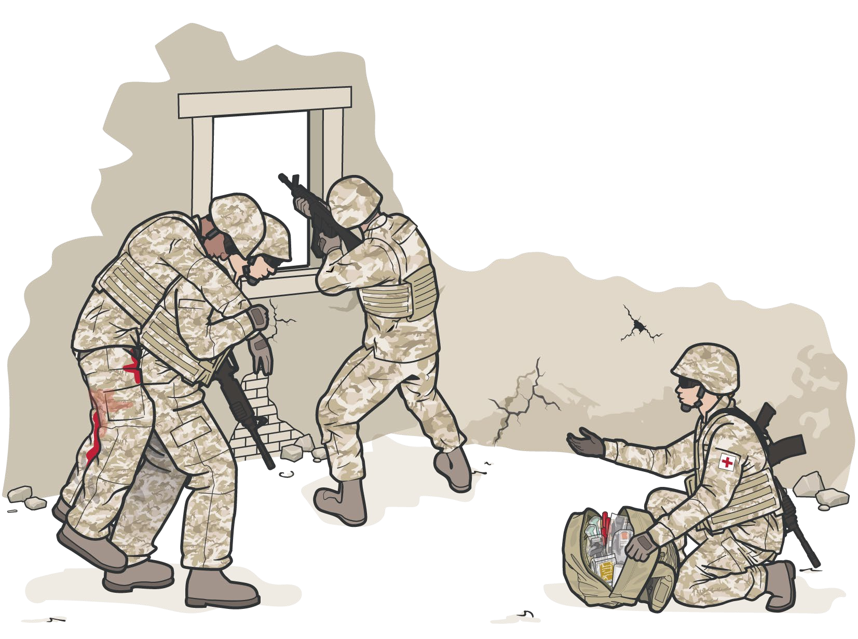
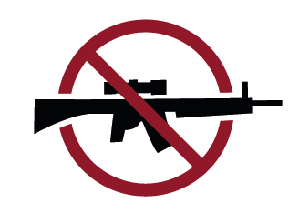

Module 4: Principles and Application of TFC
SECURITY AND SAFETY IN TFC
ESTABLISH a security perimeter in accordance with unit tactical standard operating procedures and/or battle drills
MAINTAIN tactical
situational awareness
CASUALTIES WITH ALTERED MENTAL STATUS SHOULD IMMEDIATLY HAVE:
Weapons cleared and secured Communications secured Sensitive items redistributed Weapons and radios DO NOT
mix well with shock, head injuries, or narcotics
Notes:
Presenter
2023-11-22 10:34:22
--------------------------------------------
Establish a security perimeter in accordance with unit standard operating procedures and/or battle drills.
The tactical situation is fluid and can change quickly. Maintain tactical situational awareness and be aware of your surroundings.
Casualties with altered mental status (shock, head injuries, narcotics, etc.) should immediately be disarmed of weapons, communications equipment, and/or other sensitive items. The items should then be secured by their unit point of contact (POC), taking responsibility for it.

Slide 8
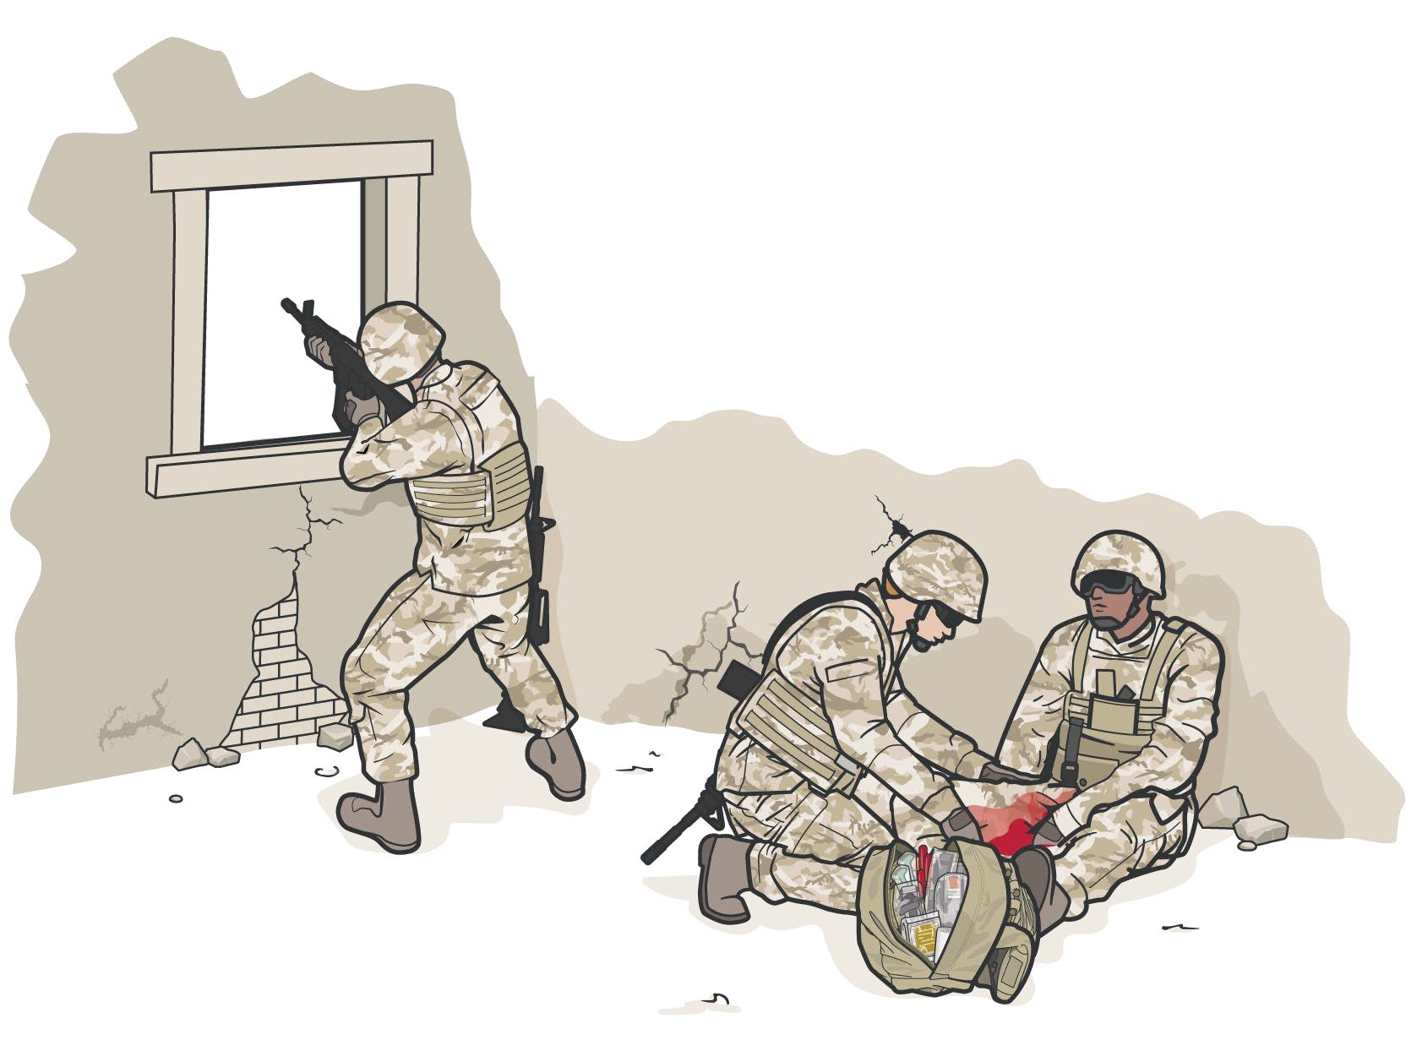
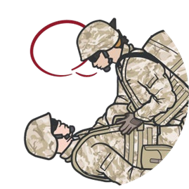
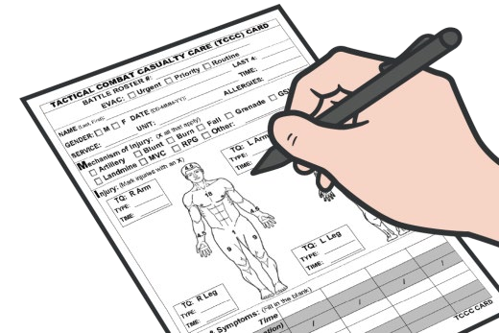
Module 4: Principles and Application of TFC
SECURITY AND SAFETY IN TFC
Combat Paramedic/Provider (CPP) and Combat Medic Corpsmen (CMC) should be ready to receive casualties in an area that provides adequate cover
COMMUNICATE
REASSESS
DIRECT ACTIONS
DOCUMENT
Notes:
Presenter
2023-11-22 10:34:22
--------------------------------------------
Always be ready to receive casualties in an area that provides adequate cover, so that lifesaving interventions can be performed. Communicate: If possible, communicate with the first responder and casualty about the MOI and what treatment has been rendered. Reassess: Always reassess lifesaving interventions that were conducted in CUF or TFC using the MARCH PAWS algorithm.
Direct Actions: If a first responder is available, direct them to assist with exposing and treating the casualty. First responders can also help to prepare medical equipment, pre-stage litters, and document basic information. Document: Ensure that you document all findings and treatments on a DD Form 1380 TCCC Casualty Card and attach it to the casualty.

Slide 9
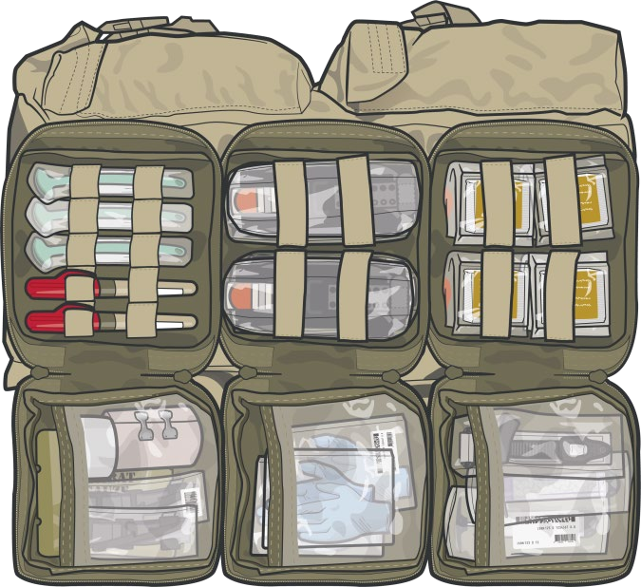
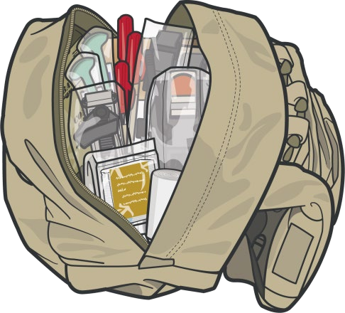
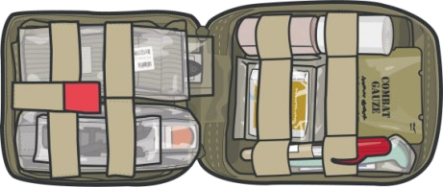
OTHER CONSIDERATIONS IN TFC
Module 4: Principles and Application of TFC
OUT OF DIRECT FIRE
TFC is when the casualty and the responder are NOT UNDER EFFECTIVE ENEMY FIRE OR DIRECT THREAT
REMEMBER
Always use the
casualty's JFAK FIRST
TFC can turn into a CUF situation unexpectedly
Personnel should maintain their situational awareness at all times
Medical personnel and first responders should be prepared to move casualties on short notice
LIMITED SUPPLIES
Medical equipment and supplies are LIMITED to what the CPP, CMCs, other unit members, and the casualty carry on the mission
Notes:
Presenter
2023-11-22 10:34:23
--------------------------------------------
In TFC, available medical equipment is still limited to that carried on the mission by the casualty (their JFAK), other first responders/CLSs (JFAK or unit combat lifesaver bag), a responding CMC and/or CPP (aid bag, etc.) Remember, whenever possible, use the casualty’s JFAK supplies first. As the tactical situation can change unexpectedly, the first responders and combat medics should be prepared to move with their casualties and equipment on short notice if needed.

Slide 10

MARCH PAWS
Module 4: Principles and Application of TFC
DURING LIFE-THREATENING AFTER LIFE-THREATENING
M A R C H
MASSIVE BLEEDING
#1 priority
P A W
PAIN ANTIBIOTICS
WOUNDS SPLINTING
AIRWAY
RESPIRATION (breathing)
CIRCULATION
S
HYPOTHERMIA /
HEAD INJURIES

Slide 11
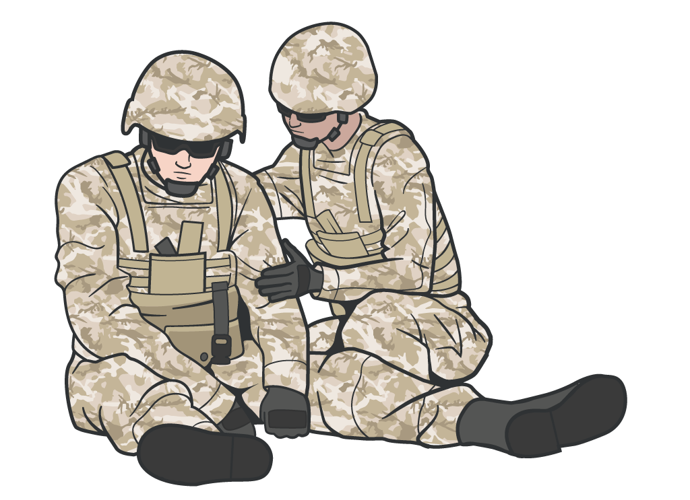
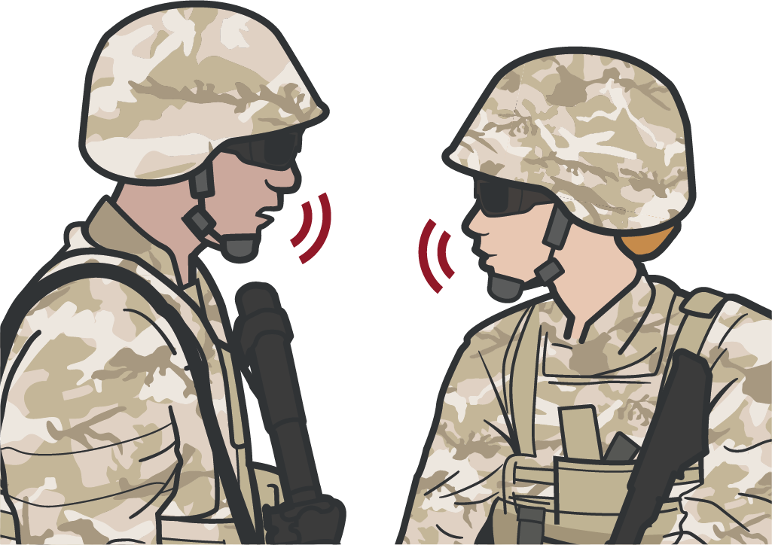
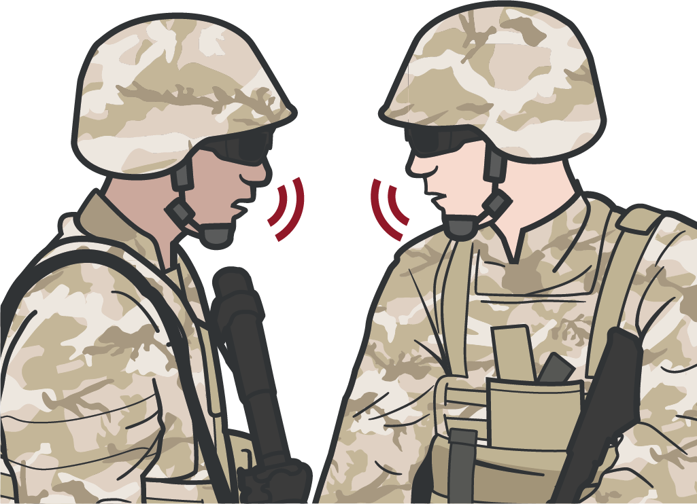
Module 4: Principles and Application of TFC
COMMUNICATION
COMMUNICATE with the
casualty, if possible
COMMUNICATE with first responders, other medical personnel, and tactical leadership about casualty injuries, condition, movement, and ongoing care
COMMUNICATE with tactical leadership IMMEDIATELY on evacuation requirements
Continue to communicate with leadership on casualty status as needed
ENCOURAGE REASSURE EXPLAIN CARE
(each step of the way)
Notes:
Presenter
2023-11-22 10:34:23
--------------------------------------------
Continuously communicate with the casualty (if possible) by encouraging, reassuring, and explaining each step of care being rendered. Being wounded can cause significant anxiety and fear above and beyond the psychological trauma of combat. Talking frankly with the casualty about their injuries and offering reassurance by describing the treatments being rendered and emphasizing that everything possible is being done to care for them can help decrease their anxiety. Be honest about the injuries sustained but maintain a positive attitude about treatment and timely evacuation. Talking with the casualty helps assess their mental status, while talking through procedures helps maintain your own focus and confidence as well as the casualty’s confidence in you. Communicate with first responders, other medical personnel, and tactical leadership about casualty injuries, condition, movement, status, and ongoing care (including annotating treatment on the DD Form 1380).
Communicate with tactical leadership immediately on evacuation requirements and throughout casualty treatment. Tactical leadership needs to understand the potential impact to the mission. Unit tactical standard operating procedures and/or battle drills will determine who will communicate with the evacuation system including the MEDEVAC requests and MIST report(s) (complete review of the MEDEVAC request and MIST report covered in Module 21). It is up to the CPP to help teach and supply information that is required for evacuation requests and reports. The CPP will continue treatment until handoff to a higher or equal to, level of care.
Example what information the tactical leadership may need to know: How many casualties?
What is the casualty's initial evacuation category? Who was injured (key leader/personnel)?
Can the casualty still fight (ambulatory vs. litter)? Urgency of evacuation?

Slide 12
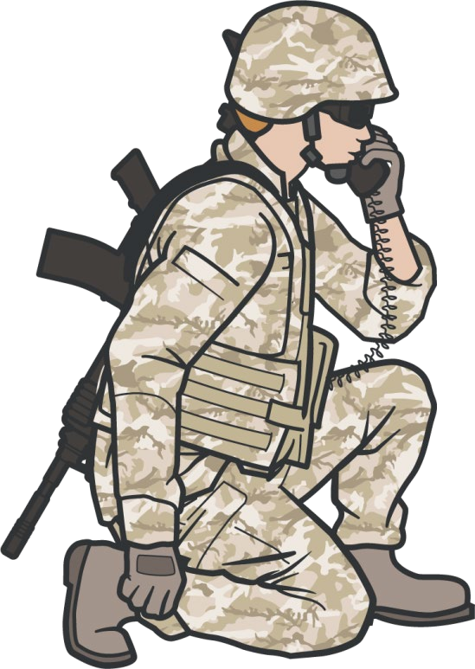
COMMUNICATE RELEVANT CASUALTY INFORMATION
Module 4: Principles and Application of TFC
DOCUMENT ALL assessments and medical care (including interventions and medications) on the DD Form 1380
Tactical Leadership will COMMUNICATE with evacuation assets using:
MEDEVAC request
MIST Report
M echanism of injury
I njuries
S ymptoms
T reatment
Relay casualty information following your unit standard operating procedures
COMMUNICATE CASUALTY DATA IN HAND-OFF WITH MEDIC OR MEDEVAC
When handing off the casualty to medic or MEDEVAC, read off DD Form 1380, including any additional information as needed
MIST report may change as the casualty status changes and in response to interventions performed
#TCCC-CPP-PPT-04-01 08 AUG 23 12
Notes:
Presenter
2023-11-22 10:34:24
--------------------------------------------
Unit tactical standard operating procedures and/or battle drills determines who communicates with evacuation assets (the medical evacuation coordination cell) to coordinate for TACEVAC/MEDEVAC and with responding medical personnel. This includes MEDEVAC requests and MIST reports, including: Number of casualties
Injuries that were sustained Status of each casualty
Treatments rendered and treatments needed Medical or evacuation equipment requirements
Document and update all casualty assessments and treatment (including interventions and medications) on the DD Form 1380 and communicate these findings during the hand-off to receiving medical and/or evacuation personnel.

Slide 13
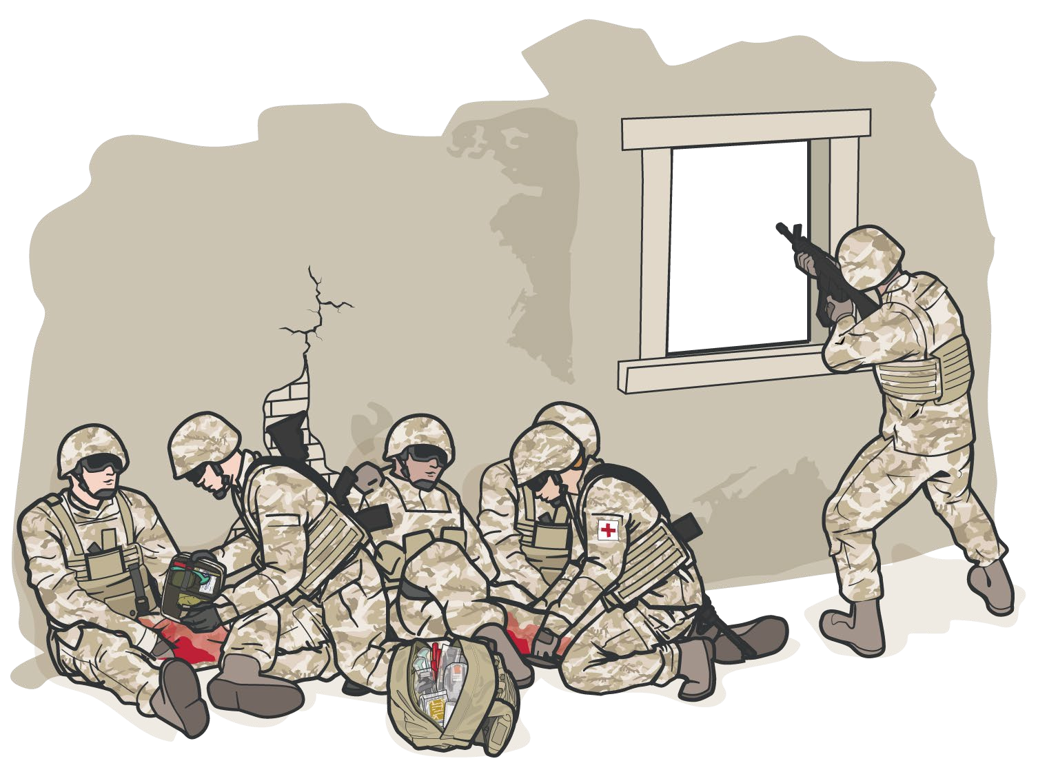
TRIAGE:
PRIORITIZING MULTIPLE CASUALTIES
Module 4: Principles and Application of TFC
Multiple casualties may need to be sorted into prioritized treatment groups
The CPP may be required to triage
casualties based on severity of injuries
The CPP will prioritize care for the most urgent casualties
First responder personnel can assist, care for less urgent casualties, monitor casualties after emergency interventions, and help prepare casualties for evacuation
Notes:
Presenter
2023-11-22 10:34:24
--------------------------------------------
Triage is the deliberate sorting of casualties and allocation of limited treatment resources according to a system of priorities designed to maximize the number of survivors on the battlefield. The tenet of triage is doing the greatest good for the greatest amount of people.
When there are multiple casualties, the CPP and/or CMC may need to triage casualties into prioritized treatment groups (immediate, delayed, minimal, expectant) based upon severity of injuries before providing care or assisting other first responders, combat lifesavers, and medical personnel with casualty care. The CPP and/or the CMC will typically care for the most urgent casualties, while other first responders assist, care for less urgent casualties, monitor casualties after emergency interventions, and help prepare casualties for evacuation.

Slide 14
TRIAGE CONSIDERATIONS
This would be an example of your immediate
Module 4: Principles and Application of TFC
#1
Massive Bleeding
#1 Priority
#2
Airway Compromise
#3
Respiratory Distress
#4
#5
Altered Mental Status
HEMORRHAGIC SHOCK
Notes:
Presenter
2023-11-22 10:34:24
--------------------------------------------
Consider these priorities (which follow the MARCH sequence) in deciding how to prioritize treatment/evacuation of multiple casualties in the TFC phase of care. This can be challenging, especially when casualties are known to the medic (in the same unit, for example).
It is particularly important not to expend limited resources (time, medical equipment and supplies, etc.) on a casualty who is not expected to reach a higher level of medical care alive, as this could compromise the treatment of higher priority patients. Expectant casualties should not be abandoned but should be treated with remaining time and resources after immediate and delayed patients have been treated.

Slide 15

Module 4: Principles and Application of TFC
Casualty Collection Point
7

Slide 16
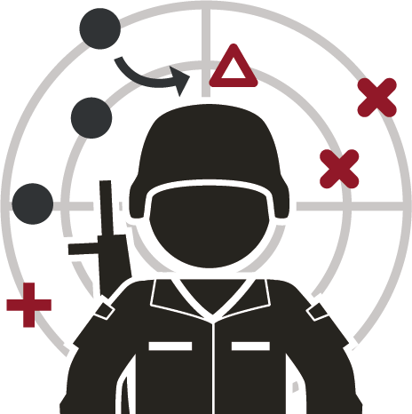
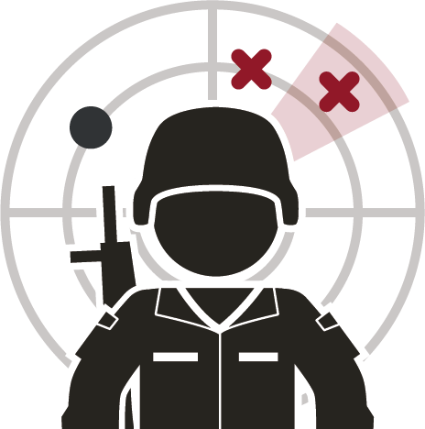

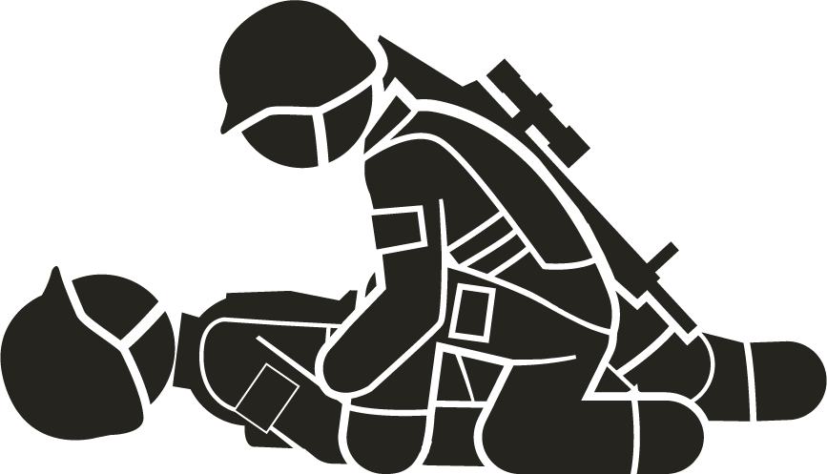
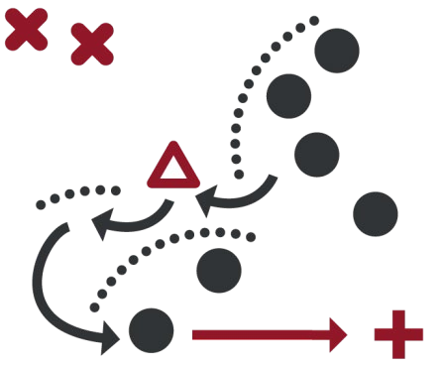


Module 4: Principles and Application of TFC
CASUALTY COLLECTION POINT SELECTION CRITERIA
SECURITY
COMMAND and
CONTROL
Appropriate TRIAGE AND MEDICAL TREATMENT
Situational
AWARENESS
ORGANIZATION
Control of EQUIPMENT
and SUPPLIES
ACCOUNTABILITY
Notes:
Presenter
2023-11-22 10:34:24
--------------------------------------------
The following are key considerations for unit leadership and medical personnel in planning, establishing, and operating a tactical CCP in support of combat operations: Maintain security
Maintain command and control
Maintain appropriate triage and medical treatment protocols Maintain situational awareness
Maintain organization
Maintain control of medical equipment and supplies Maintain accountability of personnel and casualties

Slide 17
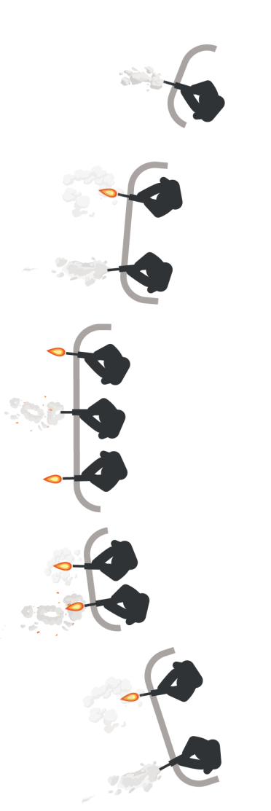
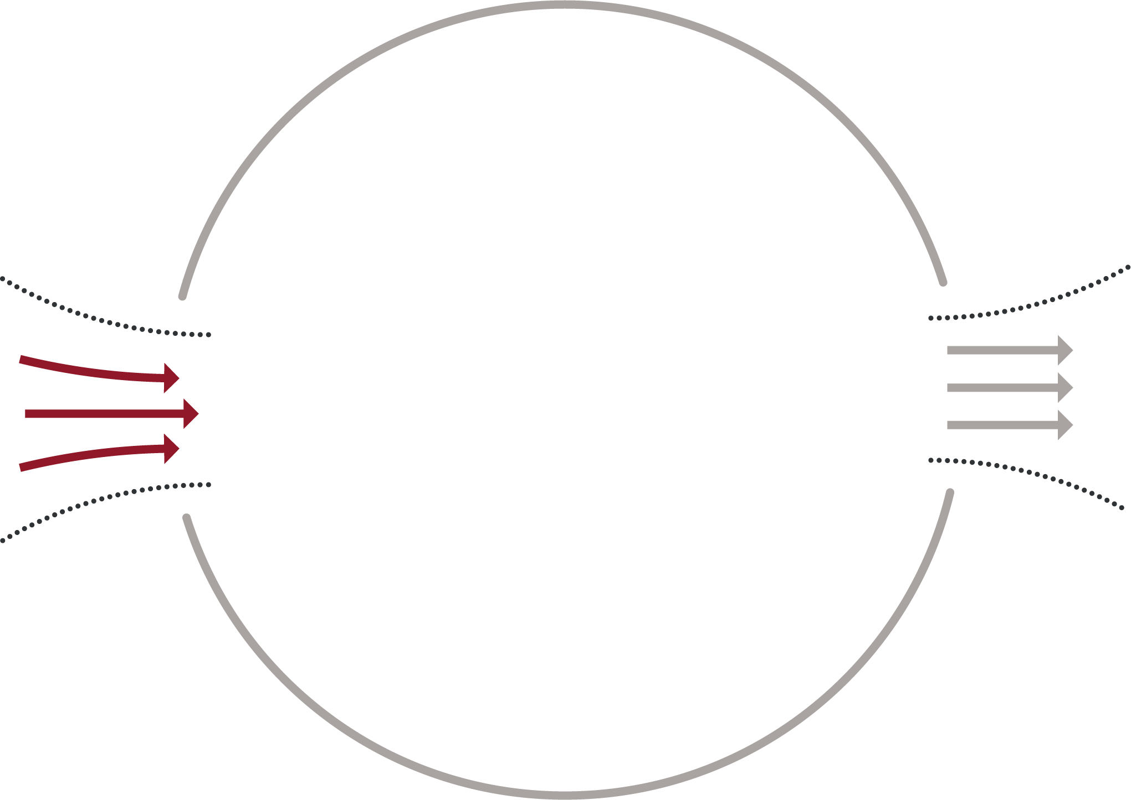






CASUALTY COLLECTION POINT PRINCIPLES
Module 4: Principles and Application of TFC
Locate CCP reasonably close to the fight
Locate near natural
"lines of drift"
Offer COVER and
CONCEALMENT from
the enemy
Have ACCESS TO EVACUATION ROUTES
Expectant
Minimal
Delayed
Immediate
Notes:
Presenter
2023-11-22 10:34:25
--------------------------------------------
The Casualty Collection Point (CCP) is a location on the battlefield for the triage, treatment and monitoring, and the packaging/staging of casualties for evacuation. Tactical Casualty Collection Points (CCPs) should be established reasonably close to the fight where casualties are likely to occur, be near natural “lines of drift,” provide relative cover and concealment from the enemy whenever possible and have access to evacuation routes.

Slide 18
Module 4: Principles and Application of TFC
CASUALTY COLLECTION POINT ROLES/RESPONSIBILITIES
UNIT LEADERSHIP | MEDICAL PERSONNEL
Security Command and Control Battlefield Situational Awareness Casualty Flow and Movement Everything outside of the CCP | Triage Casualty treatment and monitoring Casualty packaging and staging for evac Assistance requests from other units Provide guidance to leadership on casualty management and evac Manage medical equipment and supplies
Notes:
Presenter
2023-11-22 10:34:25
--------------------------------------------
Nonmedical unit leadership are typically responsible for security, command and control and battlefield situational awareness, casualty flow and movement, and everything outside of the CCP. Also, they are responsible for providing assistance to medics with augmentation, directing aid and litter teams, gathering and redistributing casualty equipment and sensitive items, providing accountability and reporting to higher authority, requesting evacuation and establishing CASEVAC or MEDEVAC link-up points, and managing KIA remains. Medical personnel are responsible for everything inside the CCP, including triage, casualty treatment and monitoring, packaging and staging casualties for evacuation, requesting assistance as needed from other unit assets, providing guidance and recommendations to leadership on casualty management and evacuation, medical equipment and supplies.

Slide 19
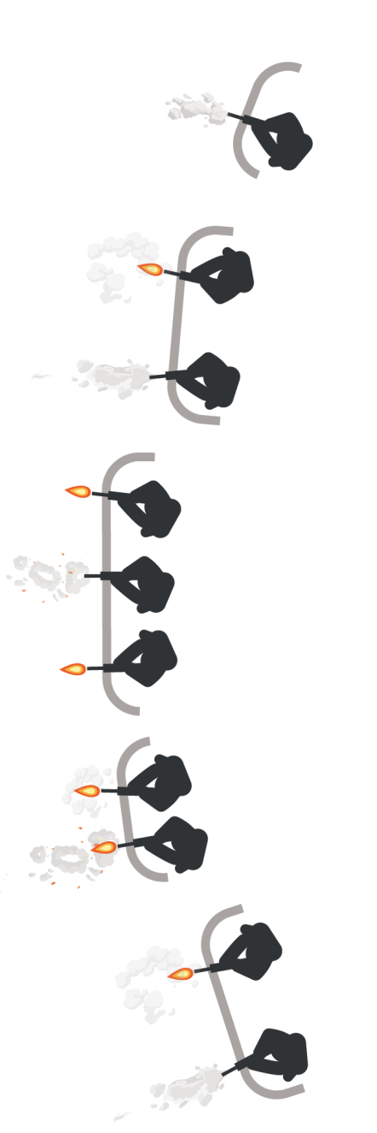
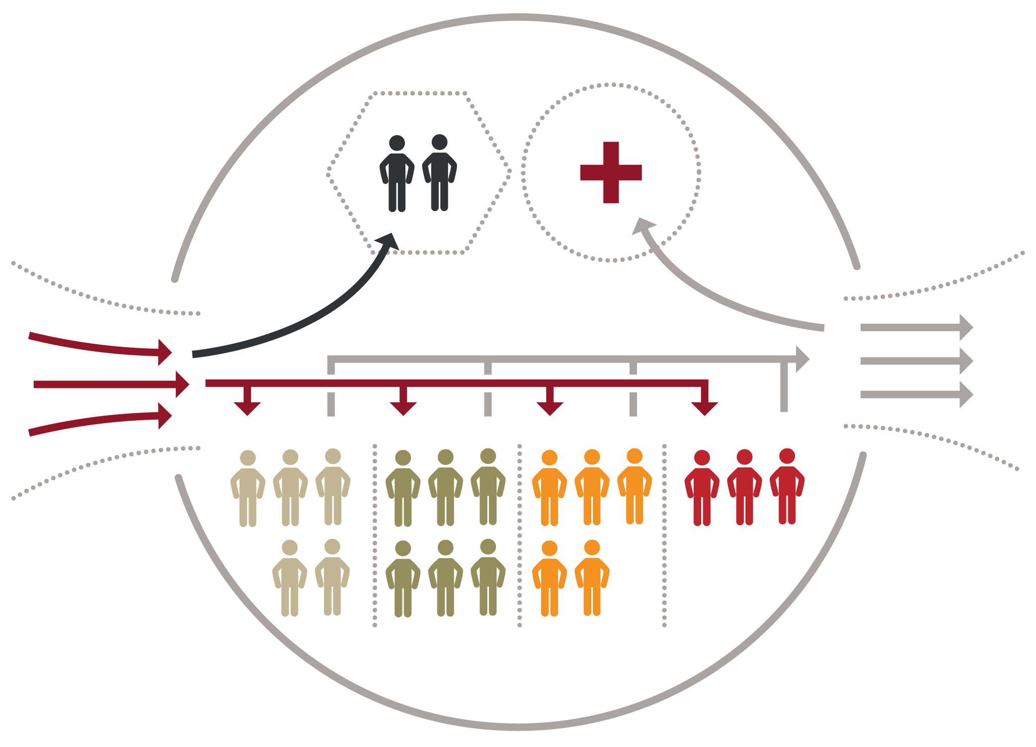



Module 4: Principles and Application of TFC
CASUALTY COLLECTION POINT LAYOUT AND MANAGEMENT
KIA Morgue
Supplies
Incoming Casualties
Outgoing Casualties
TRIAGE
ENTRY CHOKEPOINT
EXIT CHOKEPOINT
ROUTINE
PRIORITY
URGENT
Minimal/Expectant
Delayed
Immediate
Notes:
Presenter
2023-11-22 10:34:26
--------------------------------------------
There are several different examples of potential CCP layouts, since each situation is different and the exact configuration will vary based upon unit SOPs, mission, tactical situation, terrain, etc. but the layout of a CCP follows certain principles. In a standard CCP layout, there are separate entry and exit points (which are potential chokepoints) to control casualty flow through the CCP, similar to what is seen in this example.

Slide 20

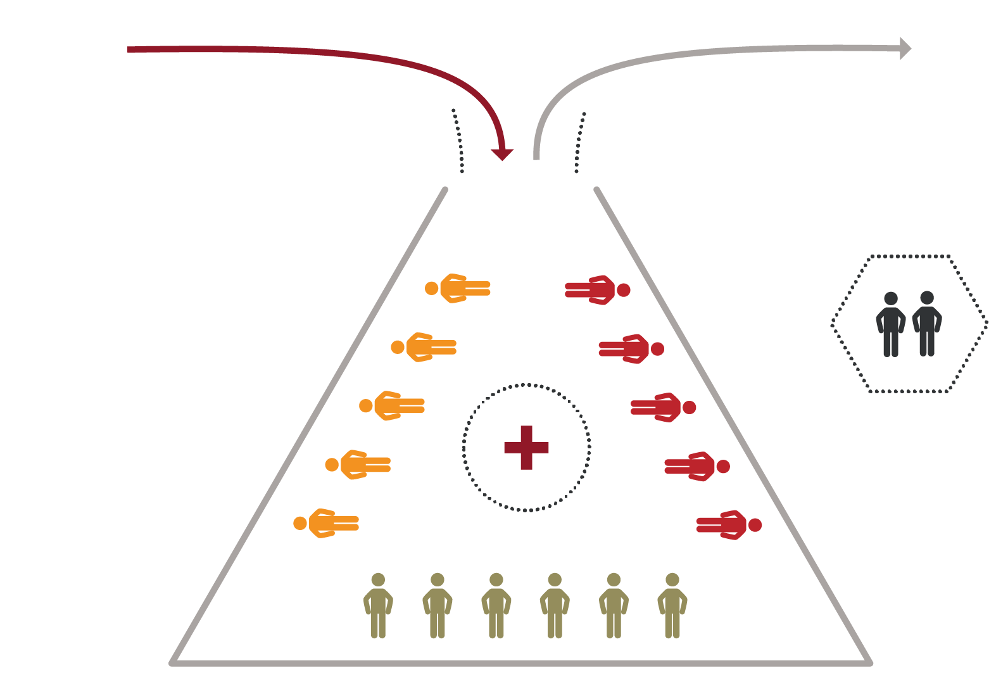
Module 4: Principles and Application of TFC
CASUALTY COLLECTION POINT LAYOUT AND MANAGEMENT (cont.)
Incoming Casualties
Outgoing Casualties
TRIAGE
ENTRY/EXIT CHOKEPOINT
KIA
Morgue
URGENT
ROUTINE
Supplies
PRIORITY
Minimal/Expectant
#TCCC-CPP-PPT-04-01 08 AUG 23
Notes:
Presenter
2023-11-22 10:34:26
--------------------------------------------
Not every situation allows for separate entry and exit points; it is easy to see how having a single entry and exit point for the CCP could create a problem with casualty flow if casualties continue to arrive as others are being moved out to the evacuation point.

Slide 21


Module 4: Principles and Application of TFC
CASUALTY COLLECTION POINT LAYOUT AND MANAGEMENT (cont.)
Establish a security perimeter in accordance with unit tactical standard operating procedures and/or battle drills.
Notes:
Presenter
2023-11-22 10:34:26
--------------------------------------------
Establish a security perimeter in accordance with unit tactical standard operating procedures and/or battle drills.

Slide 22

Module 4: Principles and Application of TFC
CASUALTY COLLECTION POINT LAYOUT AND MANAGEMENT (cont.)
Casualty movement will be provided by unit personnel in accordance with unit tactical operating procedures and/or battle drills.
Incoming Casualties
Notes:
Presenter
2023-11-22 10:34:26
--------------------------------------------
Casualty movement will be provided by unit personnel in accordance with unit tactical operating procedures and/or battle drills.

Slide 23


Module 4: Principles and Application of TFC
CASUALTY COLLECTION POINT LAYOUT AND MANAGEMENT (cont.)
TRIAGE
ENTRY CHOKEPOINT
Incoming Casualties
Triage/chokepoint will be established and controlled by unit leadership; triage and categorizing patients will be done by medical personnel
Notes:
Presenter
2023-11-22 10:34:27
--------------------------------------------
Triage/chokepoint will be established and controlled by unit leadership with medical personnel categorizing patients.

Slide 24

Module 4: Principles and Application of TFC
CASUALTY COLLECTION POINT LAYOUT AND MANAGEMENT (cont.)
TRIAGE
ENTRY CHOKEPOINT
Patients will then be placed in the Casualty Collection Point (CCP), which should be marked/identified
Incoming Casualties
Notes:
Presenter
2023-11-22 10:34:27
--------------------------------------------
Patients will then be placed in the Casualty Collection Point (CCP), which should be marked/identified.

Slide 25



Module 4: Principles and Application of TFC
CASUALTY COLLECTION POINT LAYOUT AND MANAGEMENT (cont.)
TRIAGE
ENTRY CHOKEPOINT
IMMEDIATE
These casualties require an immediate lifesaving intervention (LSI) and/or surgery. Put simply, if medical attention is not provided, they will die. The key to successful triage is to locate these individuals as quickly as possible.
Incoming Casualties
IMMEDIATE
Notes:
Presenter
2023-11-22 10:34:27
-------------------------------------------- IMMEDIATE
These casualties require an immediate lifesaving intervention (LSI) and/or surgery. Put simply, if medical attention is not provided, they will die. The key to successful triage is to locate these individuals as quickly as possible.

Slide 26
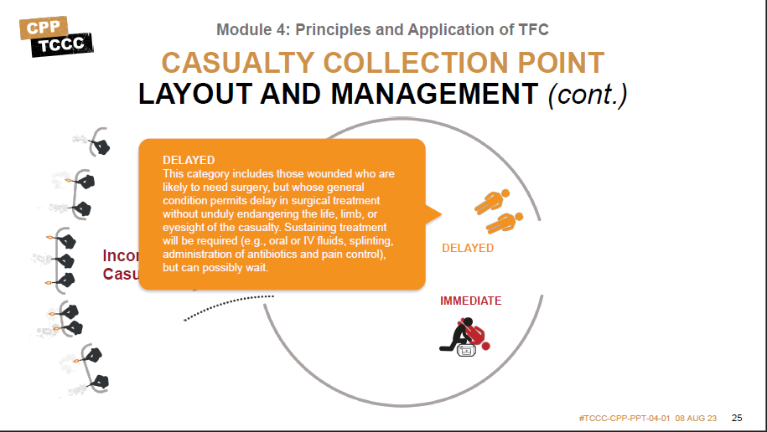
Module 4: Principles and Application of TFC
CASUALTY COLLECTION POINT LAYOUT AND MANAGEMENT (cont.)
DELAYED
IMMEDIATE
Notes:
Presenter
2023-11-22 10:34:28
--------------------------------------------
DELAYED This category includes those wounded who are likely to need surgery, but whose general condition permits delay in surgical treatment without unduly endangering the life, limb, or eyesight of the casualty. Sustaining treatment will be required (e.g., oral or IV fluids, splinting, administration of antibiotics and pain control), but can possibly wait.

Slide 27
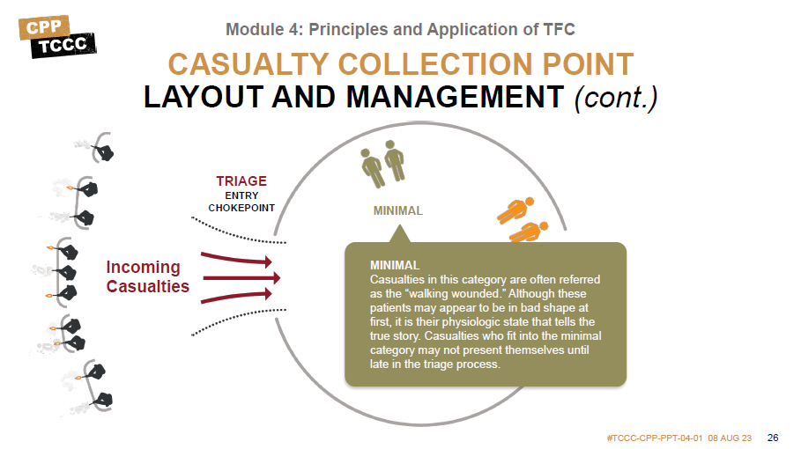





Module 4: Principles and Application of TFC
CASUALTY COLLECTION POINT LAYOUT AND MANAGEMENT (cont.)
TRIAGE
ENTRY CHOKEPOINT
MINIMAL
Incoming Casualties
MINIMAL
DELAYED
Casualties in this category are often referred as the “walking wounded.” Although these
patients may appear to be in bad shape at first, it is their phy^{I}s^{M}io^{M}lo^{E}gi^{D}c^{IA}st^{T}a^{E}te that tells the true story. Casualties who fit into the minimal category may not present themselves until late in the triage process.
Notes:
Presenter
2023-11-22 10:34:28
--------------------------------------------
MINIMAL Casualties in this category are often referred as the “walking wounded.” Although these patients may appear to be in bad shape at first, it is their physiologic state that tells the true story. Casualties who fit into the minimal category may not present themselves until late in the triage process.

Slide 28




Module 4: Principles and Application of TFC
CASUALTY COLLECTION POINT LAYOUT AND MANAGEMENT (cont.)
TRIAGE
ENTRY CHOKEPOINT
MINIMAL
/EXPECTANT
EXPECTANT
Casualties in this category have wounds that are so extensive, that even if they were the sole casualty and had the benefit of optimal medical resources, their survival would be highly unlikely. Even so, expectant casualties should not be neglected. They should receive comfort measures and pain medication if possible, and they deserve re-triage as appropriate.
Incoming Casualties
DELAYED
.
Notes:
Presenter
2023-11-22 10:34:28
--------------------------------------------
EXPECTANT Casualties in this category have wounds that are so extensive, that even if they were the sole casualty and had the benefit of optimal medical resources, their survival would be highly unlikely. Even so, expectant casualties should not be neglected. They should receive comfort measures and pain medication if possible, and they deserve retriage as appropriate.

Slide 29


Module 4: Principles and Application of TFC
CASUALTY COLLECTION POINT LAYOUT AND MANAGEMENT (cont.)
TRIAGE
ENTRY CHOKEPOINT
EXIT CHOKEPOINT
MINIMAL
/EXPECTANT
DELAYED
Outgoing Casualties
Incoming Casualties
IMMEDIATE
Once moving out with the casualties they will then pre- stage the casualties near the landing zone and prioritize evacuation by establishing who is Urgent, Priority, or Routine.
Notes:
Presenter
2023-11-22 10:34:28
--------------------------------------------
Medical personnel are responsible for everything inside the CCP, including triage, casualty treatment and monitoring, packaging and staging casualties for evacuation, requesting assistance as needed from other unit assets, providing guidance and recommendations to leadership on casualty management and evacuation, medical equipment and supplies.
In an ideal layout, there are separate entry and exit points (which are potential chokepoints) to control casualty flow through the CCP, similar to what is seen in this example.

Slide 30


Module 4: Principles and Application of TFC
CASUALTY COLLECTION POINT LAYOUT AND MANAGEMENT (cont.)
TRIAGE
ENTRY CHOKEPOINT
Unit leadership will determine where the pre-stage evacuation area will be placed, as well as securing the MEDEVAC/ TACEVAC zone.
The medic is in charge of categorizing the casualties by evacuation category (Urgent, Priority, Routine).
MINIMAL
/EXPECTANT
securing the MEDEVAC/
URGENT
DELAYTEADCEVAC
Outgoing Casualties
Incoming Casualties
PRIORITY
categorizing the casalties by
ROUTINE
_{IMMED}e_{IA}v_{T}ac_{E}uation category (Urgent, Priority, Routine).
Notes:
Presenter
2023-11-22 10:34:29
--------------------------------------------
Unit leadership will determine where the pre-stage evacuation area will be placed, as well as securing the MEDEVAC/ TACEVAC zone. The medic is in charge of categorizing the casualties by evacuation category (Urgent, Priority, Routine).

Slide 31
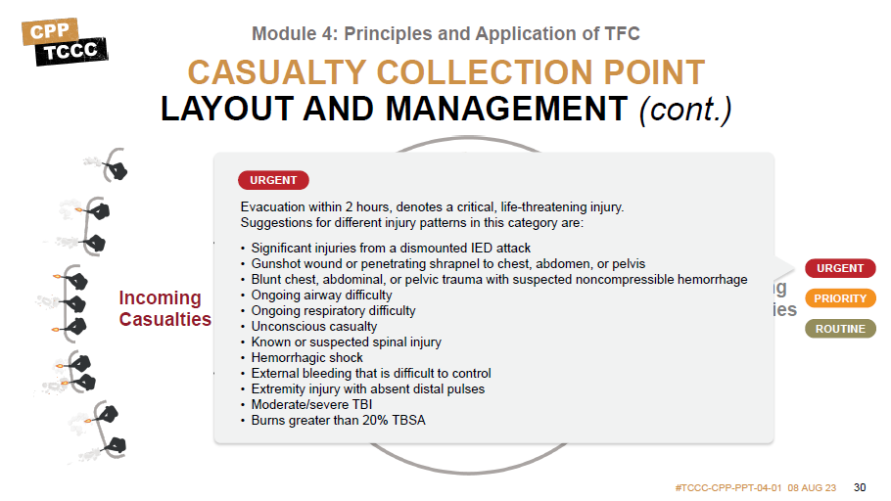




Module 4: Principles and Application of TFC
CASUALTY COLLECTION POINT LAYOUT AND MANAGEMENT (cont.)
URGENT
E^{T}v^{R}a^{I}c^{A}u^{G}at^{E}ion within 2 hours, denotes a critical, life-threatening injury.
Su^{E}g^{N}g^{T}e^{R}s^{Y}tions for different injury patterns in this category are:
EXIT CHOKEPOINT
CHOKEPOINT
MINIMAL
Significant injuries from a d_{/E}is_{X}m_{P}o_{E}u_{C}n_{T}te_{A}d_{N}I_{T}ED attack
Gunshot wound or penetrating shrapnel to chest, abdomen, or pelvis
Blunt chest, abdominal, or pelvic trauma with suspected noncompressible hemo_{O}rrh_{u}a_{t}g_{g}e_{oing}
URGENT
Incoming Casualties
Ongoing airway difficulty
Ongoing respiratory difficulty
Unconscious casualty
Known or suspected spinal injury
Hemorrhagic shock
External bleeding that is difficult to control
Extremity injury with absent distal pulses
Moderate/severe TBI
Burns greater than 20% TBSA
DELAYED
Casualties
PRIORITY
ROUTINE
IMMEDIATE
Notes:
Presenter
2023-11-22 10:34:29
--------------------------------------------
URGENT Evacuation within 2 hours, denotes a critical, life-threatening injury. Suggestions for different injury patterns in this category are: Significant injuries from a dismounted IED attack
Gunshot wound or penetrating shrapnel to chest, abdomen, or pelvis
Blunt chest, abdominal, or pelvic trauma with suspected noncompressible hemorrhage Ongoing airway difficulty
Ongoing respiratory difficulty Unconscious casualty
Known or suspected spinal injury Hemorrhagic shock
External bleeding that is difficult to control Extremity injury with absent distal pulses Moderate/severe TBI
Burns greater than 20% TBSA

Slide 32
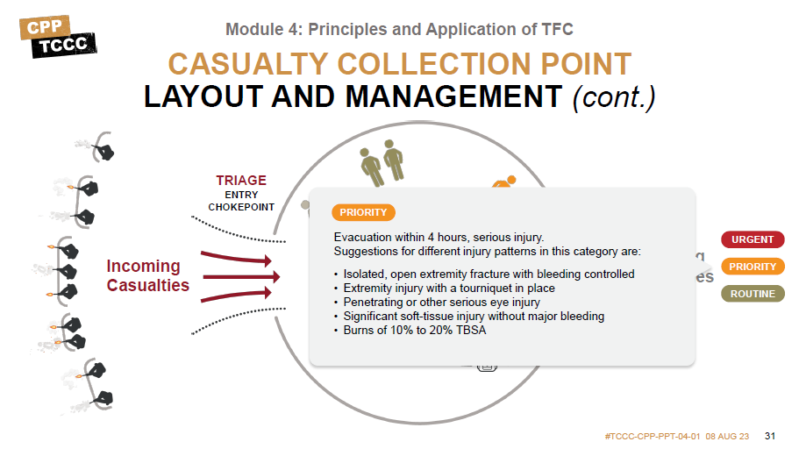

Module 4: Principles and Application of TFC
CASUALTY COLLECTION POINT LAYOUT AND MANAGEMENT (cont.)
TRIAGE
ENTRY CHOKEPOINT
EXIT CHOKEPOINT
PRIORIMTYINIMAL
/EXPECTANT
Evacuation within 4 hours, serious injury.
Suggestions for different injury patterns in this category ar_{O}e: _{utgoing}
URGENT
Incoming Casualties
DELAYED
Isolated, open extremity fracture with bleeding controlled_{Casualties}
PRIORITY
Extremity injury with a tourniquet in place
Penetrating or other serious eye injury
Significant soft-tissue inIMjuMryEwDiItAhoTuEt major bleeding
Burns of 10% to 20% TBSA
ROUTINE
Notes:
Presenter
2023-11-22 10:34:30
--------------------------------------------
PRIORITY Evacuation within 4 hours, serious injury. Suggestions for different injury patterns in this category are: Isolated, open extremity fracture with bleeding controlled
Extremity injury with a tourniquet in place Penetrating or other serious eye injury
Significant soft-tissue injury without major bleeding Burns of 10% to 20% TBSA

Slide 33
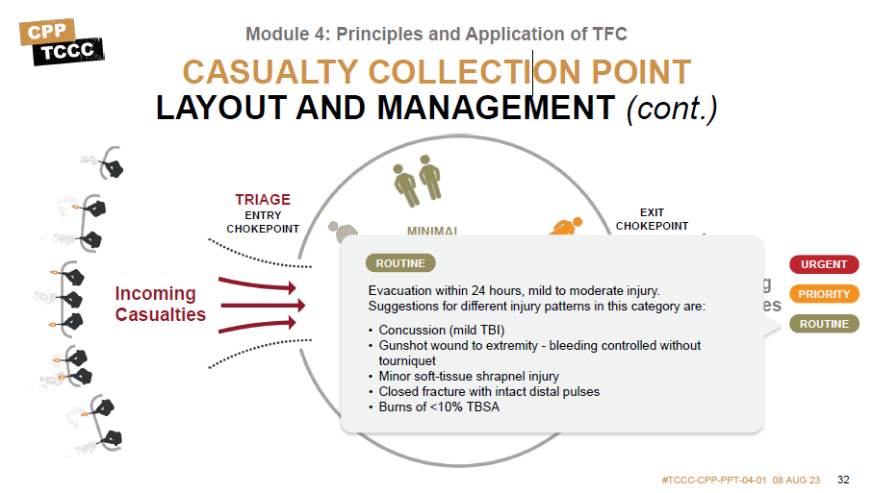

Module 4: Principles and Application of TFC
CASUALTY COLLECTION POINT LAYOUT AND MANAGEMENT (cont.)
TRIAGE
ENTRY CHOKEPOINT
EXIT CHOKEPOINT
MINIMAL
/EXPECTANT
ROUTINE
URGENT
Outgoing
Incoming Casualties
PRIORITY
ROUTINE
Notes:
Presenter
2023-11-22 10:34:30
--------------------------------------------
ROUTINE Evacuation within 24 hours, mild to moderate injury. Suggestions for different injury patterns in this category are: Concussion (mild TBI)
Gunshot wound to extremity - bleeding controlled without tourniquet Minor soft-tissue shrapnel injury
Closed fracture with intact distal pulses Burns of <10% TBSA

Slide 34
Module 4: Principles and Application of TFC
CASUALTY COLLECTION POINT
LAYOUT AND RESPONSIBILITY considerations
TRIAGE
ENTRY CHOKEPOINT
EXIT CHOKEPOINT
MINIMAL
/EXPECTANT
URGENT
DELAYED
Outgoing Casualties
Incoming Casualties
PRIORITY
ROUTINE
IMMEDIATE
Notes:
Presenter
2023-11-22 10:34:30
--------------------------------------------

Slide 35


SKILL STATIONS
Module 8: Respiration Assessment & Management in TFC
Communication of Casualty Information
Tactical Field Care Casualty Collection Point (CCP)
#TCCC-CPP-PPT-08 08 AUG 23
Notes:
Presenter
2023-11-22 10:34:30
--------------------------------------------
During this skill station, you will be able to practice performing needle decompression of the chest, finger thoracostomy, and tube thoracostomy.

Slide 36
SUMMARY
Module 4: Principles and Application of TFC
Knowledge Topics
Importance of security and safety in TFC
Basic principles of removal/extraction of casualties from a unit specific platform
Identify the relevant tactical and casualty data involved in communicating casualty information
Triage consideration in TFC
Roles, Responsibilities, planning considerations, and management of a CCP
Skills and Abilities
Communication of casualty information to tactical leadership and medical personnel
Consolidation and triage of casualties in a CCP
Notes:
Presenter
2023-11-22 10:34:30
--------------------------------------------
Tactical Field Care is the care rendered once the Combat Medic/Corpsman and/or CPP and casualty are no longer under direct threat from effective enemy fire. This allows for the time and the relative safety for a more deliberate approach to casualty assessment and treatment.
The tactical situation is fluid and can change quickly. Maintain situational awareness. Establish a security perimeter in accordance with unit standard operating procedures and/or battle drills. Casualties with altered mental status should be disarmed and weapons communications equipment, and other sensitive items should be secured/redistributed. In the Tactical Field Care phase, MARCH PAWS is followed for a more deliberate approach to the assessment and treatment of casualties than was possible during Care Under Fire. A full tactical trauma assessment should follow the steps of the MARCH PAWS sequence.
In TFC the Combat Medic/Corpsman and/or CPP should communicate with the casualty throughout assessment and treatment, communicate with other first responders, Combat Lifesavers, and medical providers regarding casualty assessment and treatment (using the DD 1380), communicate casualty status and evacuation requirements with tactical leadership, and communicate with the evacuation system (TACEVAC) including MEDEVAC requests and MIST reports.
When there are multiple casualties, the Combat Medic/Corpsman and/or CPP may need to triage casualties into prioritized treatment groups (immediate, delayed, minimal, expectant) based upon severity of injuries prior to providing or assisting other first responders, Combat Lifesavers, and medical personnel with casualty care. The Combat Medic/Corpsman and/or CPP should consider MARCH in deciding how to prioritize treatment and evacuation of multiple casualties in the TFC phase of care. The Casualty Collection Points (CCPs) should be established reasonably close to the fight where casualties are likely to occur, be near natural “lines of drift”, provide relative cover and concealment from the enemy whenever possible, and have access to evacuation routes.

Slide 37


CHECK ON LEARNING
Module 4: Principles and Application of TFC
What is the difference between TFC and CUF?
True or False: During TFC, the tactical situation could change back to CUF again at any time?
What is MARCH PAWS? What is triage?
What is a CCP?
Notes:
Presenter
2023-11-22 10:34:31
--------------------------------------------
Ask questions of the learners, referring to key concepts from the module. Now for a check on learning.
1. What is the difference between TFC and CUF?
Answer: Tactical Field Care is the care rendered once the Combat Medic/Corpsman and/or CPP and casualty are no longer under direct threat from effective enemy fire. This allows for the time and the relative safety for a more deliberate approach to casualty assessment and treatment.
2. True or False: During TFC, the tactical situation could change back to CUF again at any time? Answer: True.
3. What is MARCH PAWS?
Answer: In the Tactical Field Care phase, the MARCH PAWS sequence is followed for a more deliberate approach to the assessment and treatment of casualties than was possible during Care Under Fire. A full tactical trauma assessment should follow the steps of the MARCH PAWS sequence. 4. What is triage?
Answer: Triage is the deliberate sorting of casualties and allocation of limited treatment resources according to a system of priorities designed to maximize the number of survivors on the battlefield.
5. What is a CCP?
Answer: The Casualty Collection Point (CCP) is a location on the battlefield for the triage, treatment and monitoring, and the packaging/staging of casualties for evacuation. The CCP should be established reasonably close to the fight where casualties are likely to occur, be near natural “lines of drift”, provide relative cover and concealment from the enemy whenever possible, and have access to evacuation routes.

Slide 38




Module 4: Principles and Application of TFC
ANY QUESTIONS?

Slide 39
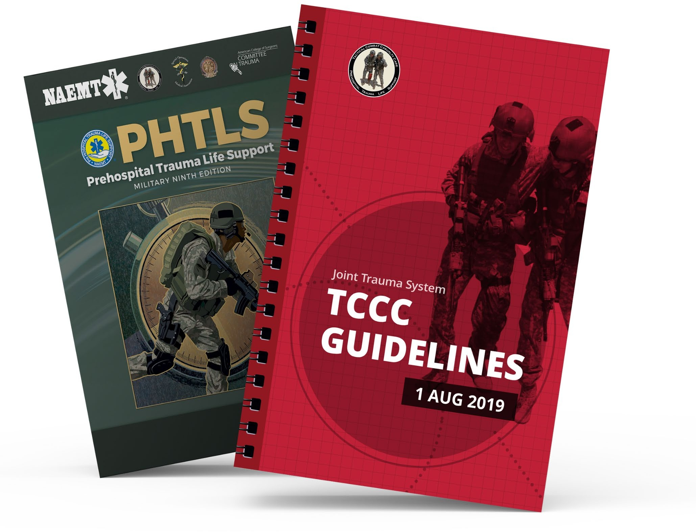

REFERENCES
Module 4: Principles and Application of TFC
TCCC: Guidelines
by JTS/CoTCCC
These guidelines, updated regularly, are the result of decisions made by CoTCCC in exploring evidence-based research on best practices.
PHTLS: Military Edition Chapters 25
by NAEMT
Prehospital Trauma Life Support (PHTLS), Military Edition, teaches and reinforces the principles of rapidly assessing a trauma patient using an orderly approach.
Notes:
Presenter
2023-11-22 10:34:35
--------------------------------------------
Throughout the course, you’ll note several references, but keep in mind that the TCCC Guidelines are the core guidance for assessing and treating casualties in a TCCC setting, as well as the emphasis for training. Likewise, the Prehospital Trauma Life Support (PHTLS), Military Edition, teaches and reinforces the principles of rapidly assessing a trauma patient using an orderly approach.

